Slide 1
Key words
Diffraction
Illuminate
Overlap
Coincide
Resolvability
Circular Aperture
Angular separation
Rayleith’s Criterion
Envelope

Slide 2
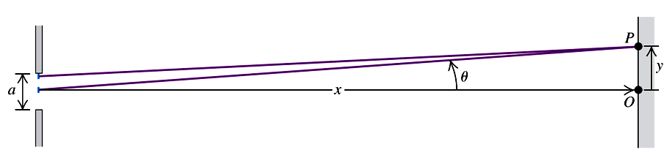


Diffraction (衍射)
A dark fringe occurs whenever :
What if λ = a ?
Bright fringe cover the whole screen
Since sin θ ≈ θ when θ is small (θ in radians)
What if a >> λ ?
θ goes to zero, all the fringes are overlapped, so only a point presented on the screen. That what we have seen in daily life.

Slide 3
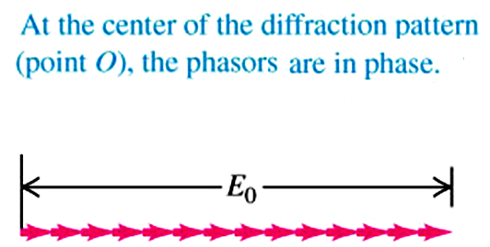
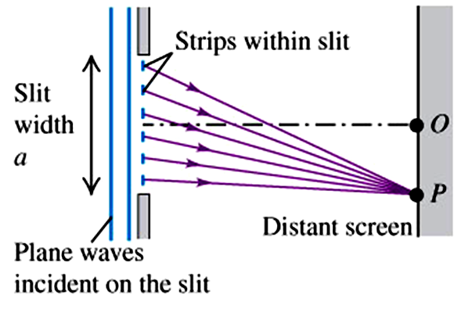
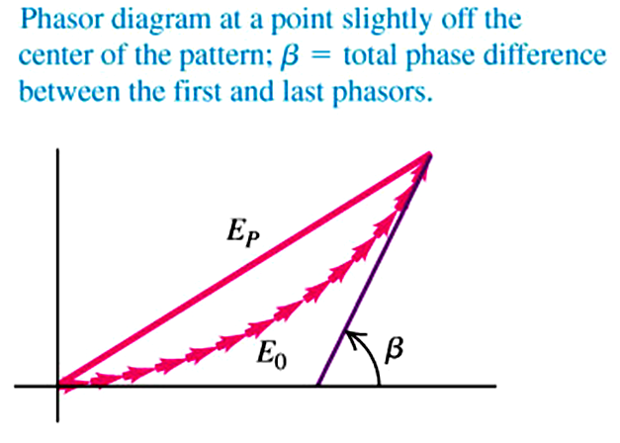
Intensity of the single-slit diffraction pattern
We have to consider the E-field of each point source

Slide 4
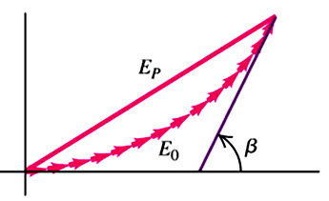
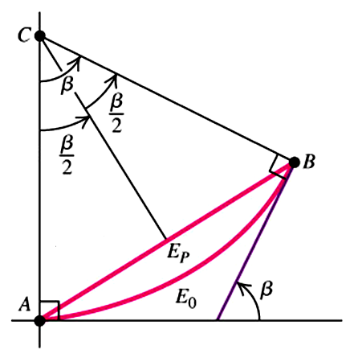
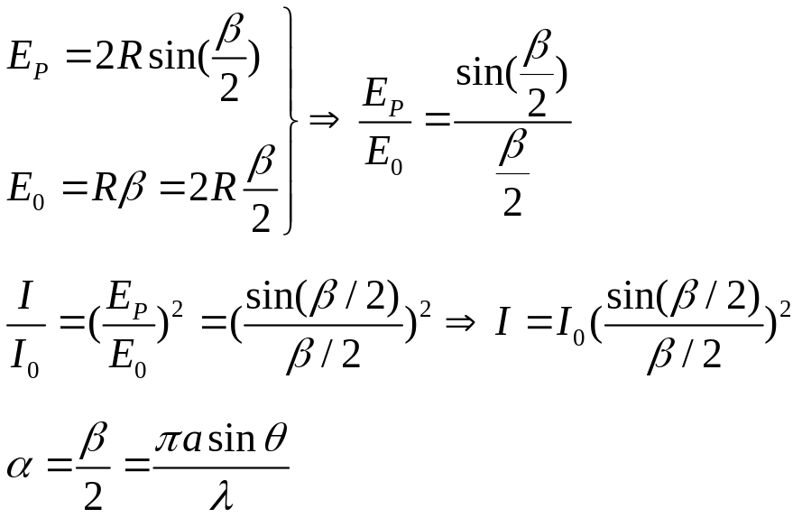

Intensity of the single-slit diffraction pattern
β : phase difference in radians between the oscillations at points P resulting from the first and last point source at the slit

Slide 5
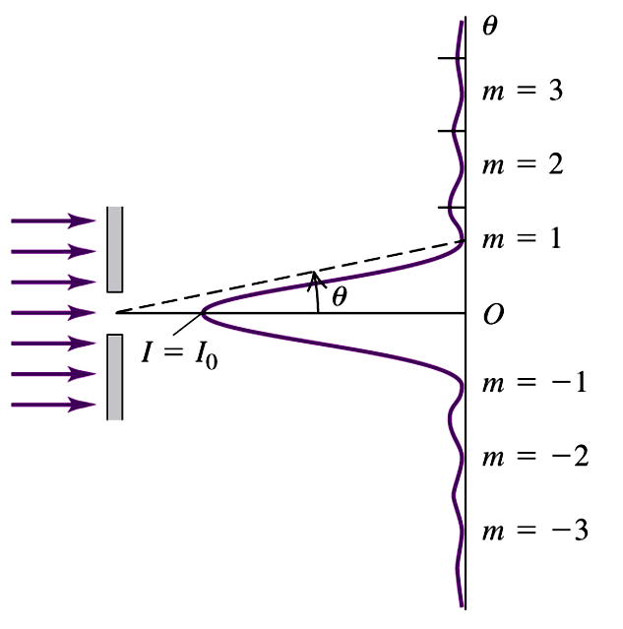


Intensity of the single-slit diffraction pattern
Angular position θ of the dark fringes :
Intensity at any point on the screen in terms of phase difference β for the first and last point source at the slit :
To relate the two, we have

Slide 6

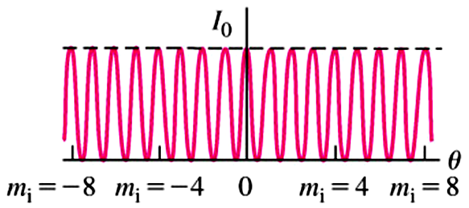
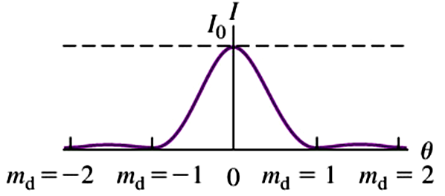


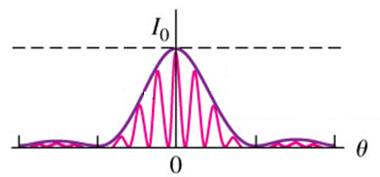


A realistic case of two-slit interference pattern
Slit width a
light
Distance between slits d = 4a
Assume very narrow slit, we have interference pattern :
d sinθ = mλ ( m = 0, ± 1, ± 2, ….) Bright fringes
sinθ = mλ / 4a
In real, the slit width a will have a diffraction pattern :
Dark fringes
For intensity, we combine the two :

Slide 7
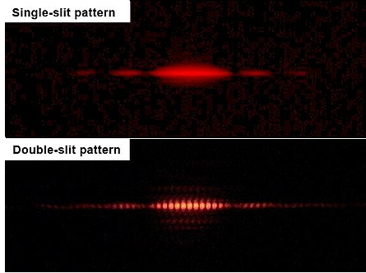

Slide 8
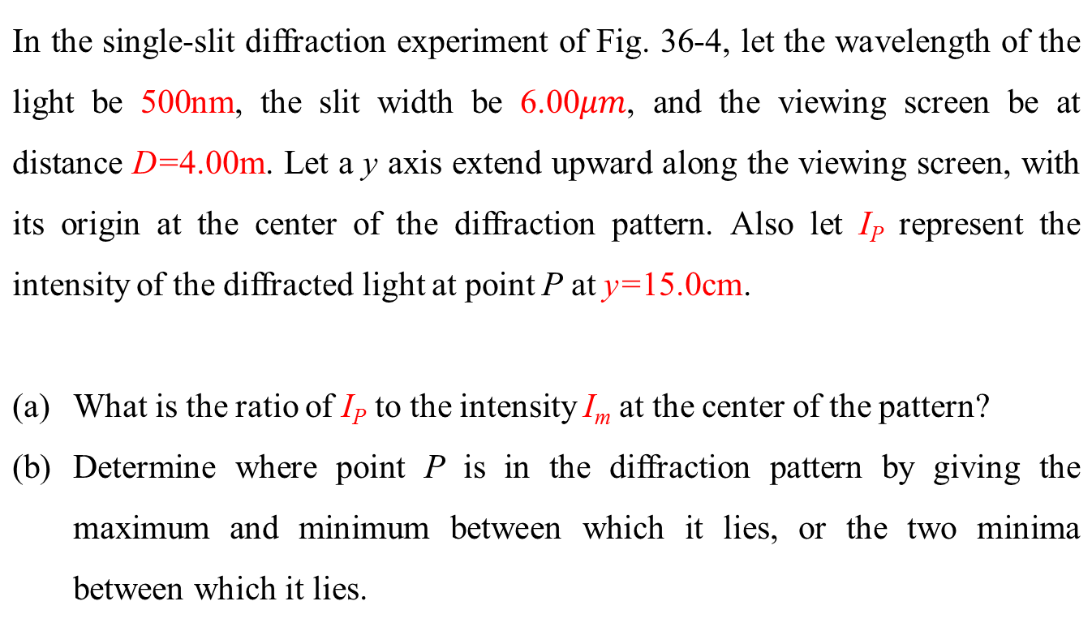
Question 1

Slide 9

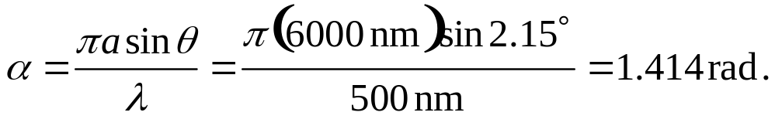
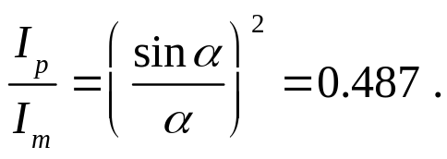
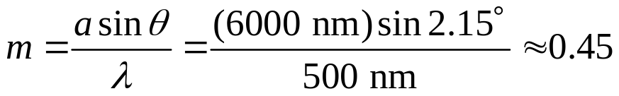
Question 1
Thus,
(b) Consider Eq. 36-3 with “continuously variable” m (of course, m should be an integer for diffraction minima, but for the moment we will solve for it as if it could be any real number):

Slide 10
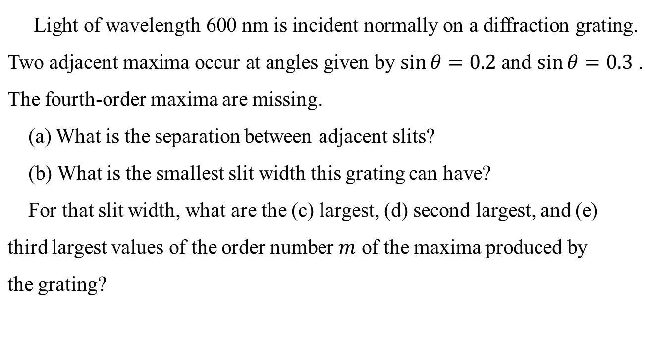
Question 2
double slits.
slits
slits

Slide 11
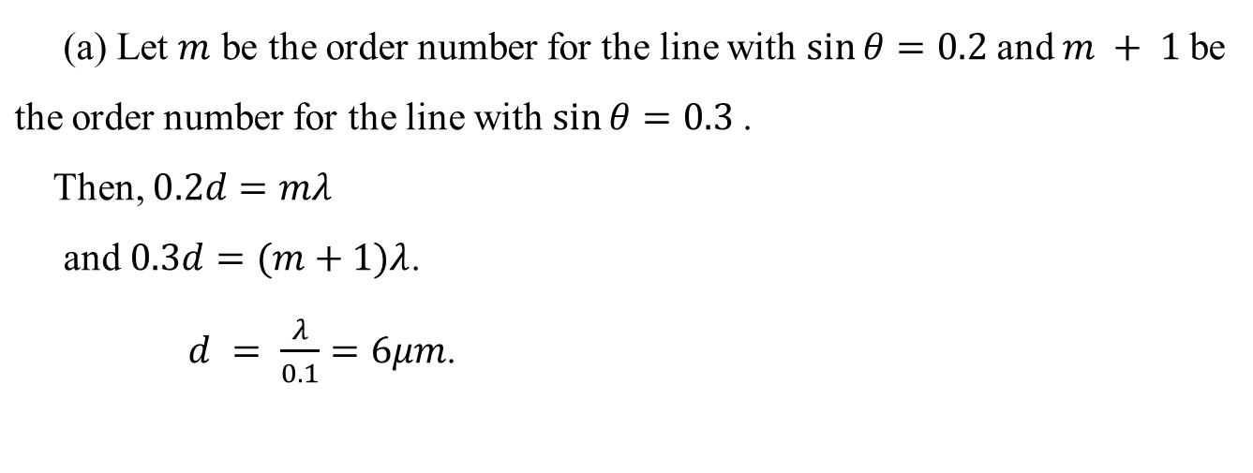
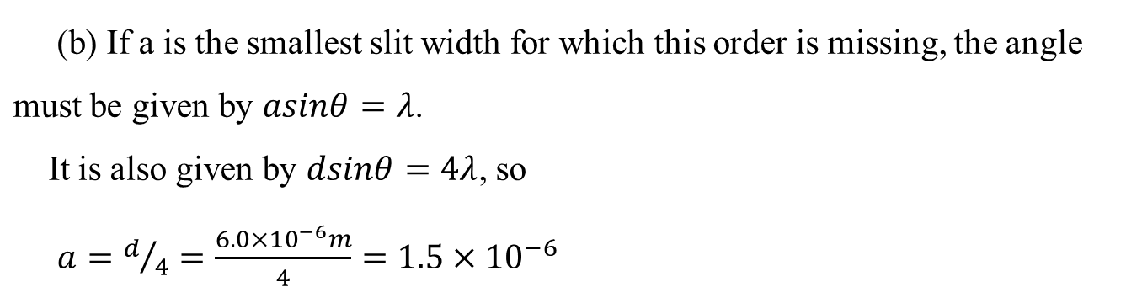
Question 2 (Solution)
m

Slide 12
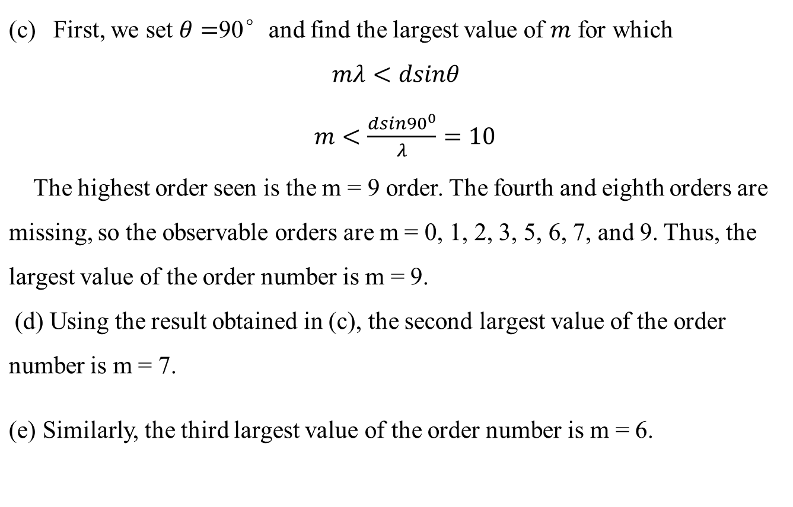
Question 2 (Solution)

Slide 13
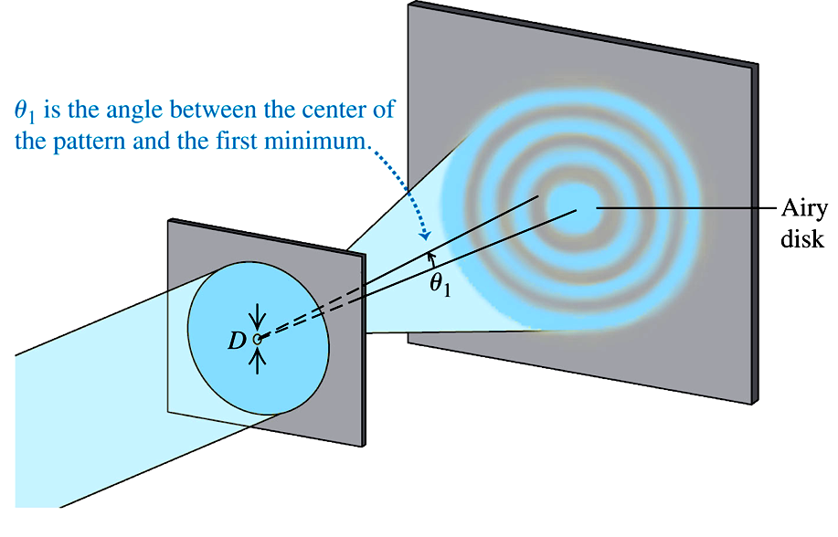


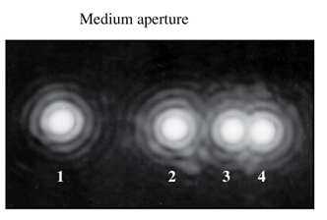
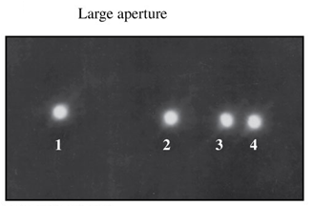
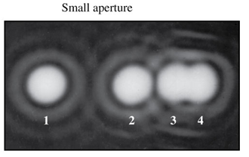
Diffraction by a circular aperture and resolvability
For circular aperture
d
Rayleigh’s criterion for resolvability : central maximum of the diffraction pattern of one source is centered on the first minimum of the diffraction patter of the other

Slide 14
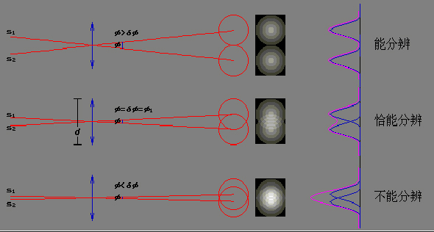





Diffraction by a circular aperture and resolvability
Rayleigh’s criterion for resolvability : central maximum of the diffraction pattern of one source is centered on the first minimum of the diffraction patter of the other

Slide 15
Question 3
Two yellow flowers are separated by 60 cm along a line perpendicular to your line of sight to the flowers. How far are you from then flowers when they are at the limit of resolution according to the Rayleigh criterion?
Assume the light from the flowers has a single wavelength of 550 nm and that your pupil has a diameter of 5.5 mm.

Slide 16
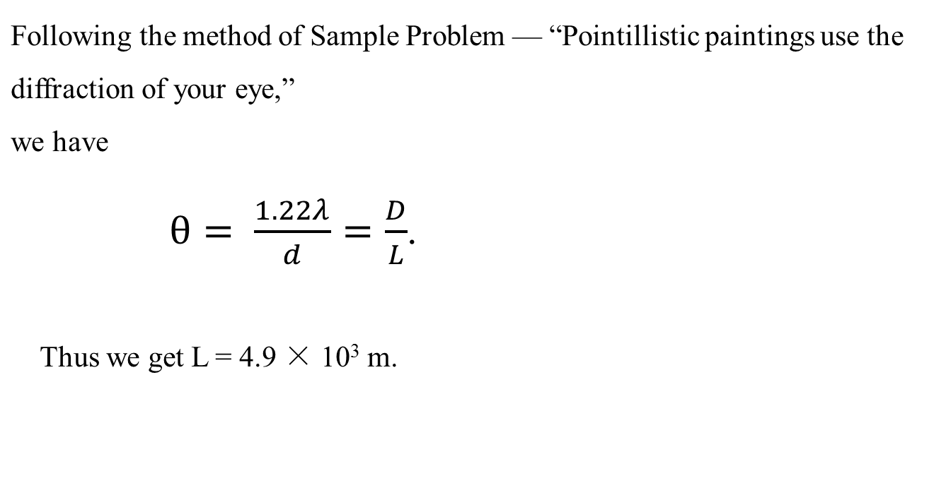
Question 3 (Solution)

